Slide 1

COLLECTIVE LEADERSHIP AND
SAFETY CULTURES
SUSTAINING IMPROVEMENTS

Slide 2

What is sustainability?
Commonly defined as when new ways of working and improved outcomes become the norm. Sustainability can be considered a process or an outcome:
Outcome: Sustainability is considered an outcome where health benefits or work activities have been maintained over time
Process: Sustainability is considered a process where there is continuous learning, adaptation and development
Lennox, L., Maher, L., & Reed, J. (2018). Navigating the sustainability landscape: a systematic review of sustainability approaches in healthcare. Implementation Science, 13(1), 27.

Slide 3
Why is sustainability important?
It is an indicator of successful implementation and change.
It is considered as one of the biggest challenges in quality improvement and change management.
A focus on sustainability will help to develop strategies to ensure that initiatives/changes become ‘what we do here’ rather than temporary changes.

Slide 4
What can inform strategies for sustainability?
Sustainability frameworks developed by the NHS Institute for Innovation and Improvement and by the HSE (Peoples’ Needs Defining Change, Health Services Change Guide (2018))
[See handouts for summaries]

Slide 5

How to ensure sustainability
Meet regularly to discuss how the team in working and how things could be improved
Reinforce and share responsibilities for on-going monitoring and reporting against goals
Feedback to other team members to support and encourage new practices
Induct new team members into ‘how we do things here’
Remain alert to changing contexts and opportunities for improvement/change
Peoples’ Needs Defining Change, Health Services Change Guide (2018). www.hse.ie/eng/staff/resources/changeguide/

Slide 6

What can we do?
NHS Sustainability Guide (2017):
  Developed a scoring sheet to help teams assess likelihood of sustainability
  Identifies what aspects are working well and where efforts should be concentrated to enhance success for sustainability
  Explores process, staff, and organisational factors
  They advise that you start by concentrating on the two or three factors with the greatest potential for improvement.

Slide 7
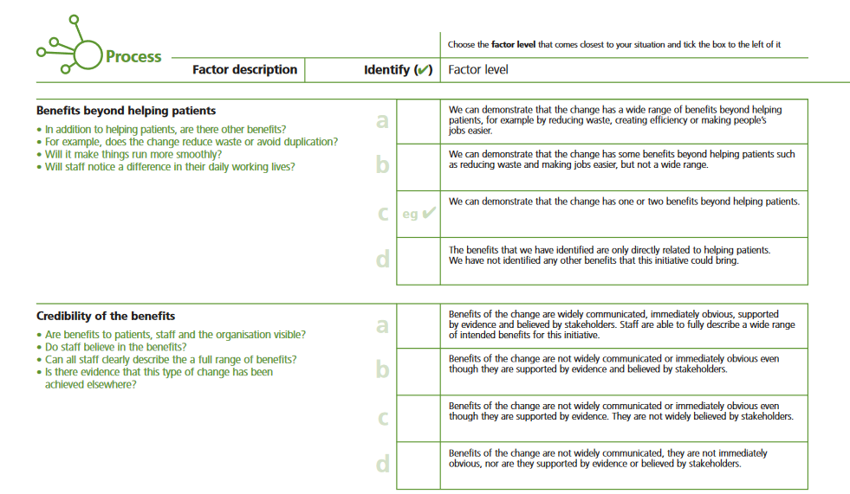
Notes:
Sample question scoring – to be completed by team to assess current status of change initiative and likelihood of sustainability

Slide 8
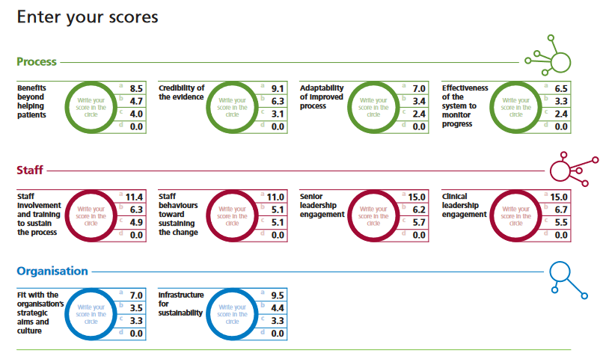
Notes:
How results are computed (based on 10 questions team should answer together to highlight factors that are working well and others that require attention to enhance the chances of successful sustainability)

Slide 9
Group Discussion

